Slide 1

2024 NASA Space Apps Challenge - PACE in the Classroom
The PACE mission will revolutionize our understanding of the ocean and its role in the Earth's climate system. This challenge invites you to develop innovative educational resources that bring PACE data to life for students and educators.
Team Name :- CodeThief

Slide 2
Problem statement: Accessibility and understanding of PACE data
Technical Barriers
Educational Gap
Engagement Challenge
PACE data is complex and requires specialized software and expertise to access and interpret.
Existing educational resources on oceanography often lack engaging and accessible content related to PACE data.
Making PACE data relevant and engaging for students, particularly younger learners, can be challenging.

Slide 3
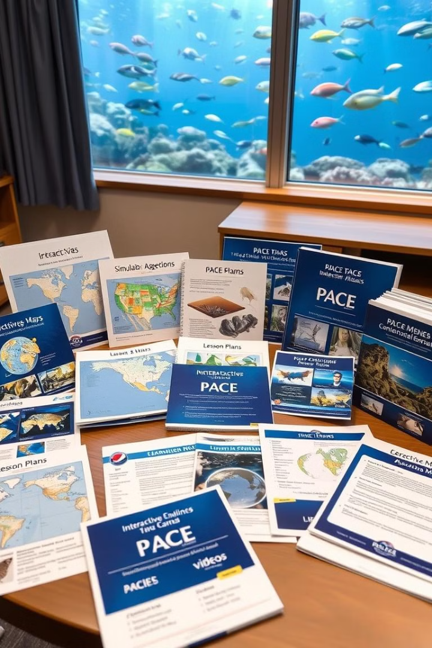




Proposed solution: Develop educational resources for PACE data
Interactive Maps
Educational Videos
Explore global oceanographic data and visualize key features.
Provide engaging explanations of PACE data and its applications.
Interactive Simulations
Lesson Plans
Curated lesson plans for educators to integrate PACE data into their curriculum.
Allow students to experiment with PACE data and understand its implications.

Slide 4

Target audience: K-12 students and educators
Grade Level
Content Focus
K-5
Basic oceanography, marine life, and the importance of the ocean.
6-8
Ocean currents, climate change, and the impact of human activities on the ocean.
9-12
Advanced oceanography, scientific research, and the use of technology to study the ocean.

Slide 5
Key features of the educational resources
1
Interactive and Engaging
2
Age-Appropriate
Content should be tailored to the specific age and learning levels of the target audience.
The resources should be interactive and engaging, using multimedia elements, games, and simulations.
3
Scientifically Accurate
4
Accessible and Free
The resources should be based on sound scientific principles and accurate information.
The resources should be freely available to all educators and students, without any cost barriers.

Slide 6













Web Application Development Stack :-
Frontend
Backend
Database
AI/ML
React
Node js
mongo DB
Bot Press
(We implement a Bot using Bot press that can give you answer of every question related to PACE data)
Tailwind
Express js
Three js
NASA API
World Map API
Redux

